Slide 1

Vaishnavi Brungi

Slide 2



Problem Statement
A grumpy backend engineer working at Reddit mistakenly deleted the "subreddit" column in the database in Australia.
None of the subreddit links will populate with posts until the subreddit column data is recovered.
To build an accurate classification model to predict which subreddit a given post belongs to.
To list down top features of each subreddit that determine where a random post belongs to.

Slide 3
The Subreddits
r/violinist
r/Cello

Slide 4
Data Collection
Pushshift API
Json Script
Feature Extraction
Data Frame
1000 most recent submissions from each subreddit were taken to conduct the analysis.
4

Slide 5
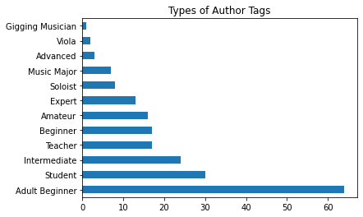
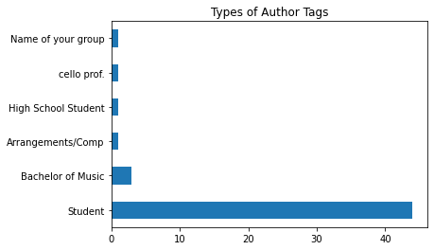
Types of author_flair_text for both subreddits
“r/violinist “
“r/Cello “

Slide 6
Data Cleaning
Renaming columns and changing column order
Converted unix/epoch time to regular time stamp in UTC
Binarized subreddit column in combined data frame
Missing value row was dropped in post_title column

Slide 7
Preprocessing
Tokenize/Stem/StopWords
TfidfVectorizer
CountVectorizer

Slide 8
Data Modelling
CountVectorized Data
TfidfVectorized Data
Model Name | Train Score | Test Score
Logistic Regression(Lasso) | 0.959 | 0.714
Logistic Regression(Ridge) | 0.952 | 0.750
Multinomial Naïve Bayes | 0.860 | 0.729
Decision Tree Classifier | 0.976 | 0.708
Bagging Classifier | 0.976 | 0.703
Random Forest Classifier | 0.976 | 0.706
Extra Trees Classifier | 0.976 | 0.724
Model Name | Train Score | Test Score
Logistic Regression(Lasso) | 0.966 | 0.726
Logistic Regression(Ridge) | 0.966 | 0.724
Multinomial Naïve Bayes | 0.873 | 0.737
Decision Tree Classifier | 0.909 | 0.745
Bagging Classifier | 0.976 | 0.716
Random Forest Classifier | 0.976 | 0.720
Extra Trees Classifier | 0.976 | 0.733

Slide 9
Model Performance Results
 | Count Vectorizer | TFIDF Vectorizer
GridSearchCV | Logistic Regression(Ridge) | Extra Trees Classifier
Parameters Tested | 'penalty': [ 'l2'], C: [0.01,0.1,1.0,10.0,50.0] | 'n_estimators': [10, 20,30,50], 'max_depth': [10,20,50,100]
Cross-Val Score | 0.733 | 0.725
Train Score | 0.847 | 0.716
Test Score | 0.714 | 0.678
Grid SearchCV train and test score of Logistic Regression(Ridge) model under the CountVectorizer is better than Extra Trees Classifier under TfidfVectorizer

Slide 10
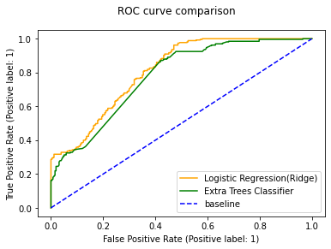
ROC Curve
Model Name | AUC ROC Score
Logistic Regression(Ridge) under CountVectorizer | 0.808
Extra Trees Classifier under TfidfVectorizer | 0.776
If AUC ROC Score is between 0.5-1,it means that our model is able to to detect more numbers of True positives and True negatives than False negatives and False positives.

Slide 11
Confusion Matrix
Predicted Violin
Predicted Cello
167
90
59
206
Actual Violin
Confusion Matrix was plotted based on best scoring model i.e., Logistic Regression (Ridge)
Actual Cello

Slide 12
Conclusions
Most common words in both the subreddits (not including ‘violin’ and ‘cello’)
Top 10 words that determines which subreddit a given post belongs to according to our model
Logistic Regression model under the CountVectorizer has the better accuracy to predict which subreddit a given post belongs to.
Common Words
‘play’
‘string’
‘bow’
‘music’
‘piec’
‘question’
‘help’
‘practic’
‘beginn’
‘learn’
Violinist | Cello
‘violin’ | ‘david’
‘violinist’ | ‘band’
‘teacher’ | ‘often’
‘play’ | ‘weight’
‘long’ | ‘either’
‘rest’ | ‘bought first’
‘shoulder’ | ‘hickey’
‘keep’ | ‘sing’
‘pleas’ | ‘talk’
‘vibrato’ | ‘camp’
Baseline Accuracy | Model Accuracy | Model Error
50% | 71.4% | 28.5%

Slide 13
Next Steps
Include author_flair_text and vectorized text column
Analyze created_utc
Collect more sample data
Remove vectorized words that are in the title of the Subreddit

Slide 14


